Slide 1


MINI PROJECT REPORT ON
SPOTIFY CHURN ANALYSIS USING POWER BI

Slide 2
CONTENTS
Introduction
Dataset Description
Objective
Tools Used
Data Preparation
Key Measures (DAX)
Dashboard Overview
Key Insights
Conclusion

Slide 3
Introduction
Customer churn is a major challenge for subscription-based platforms like Spotify. Churn refers to users who stop using a service. This project focuses on analyzing user behavior to identify patterns and factors that influence churn using Power BI.

Slide 4
Dataset Description
Dataset used: Spotify Dataset for Churn Analysis (Kaggle)
Total Records: 8000 users
Total Columns: 12 features
Data Type: Numerical and Categorical
Key columns:
Age
Gender
Country
Subscription Type
Listening Time
Songs Played per Day
Skip Rate
Device Type
Ads Listened per Week
Churn (Target Variable)

Slide 5
Objective
To analyze user behavior and identify churn patterns
To understand factors affecting customer retention
To build an interactive dashboard for data visualization
To provide insights for reducing churn

Slide 6
Tools Used
Power BI Desktop
Power Query (Data Cleaning)
DAX (Measures and Calculations)

Slide 7
Data Preparation
Checked and corrected data types
Created new columns:
  Age Group
  Listening Category
  Churn Status
Removed inconsistencies (if any)

Slide 8
Key Measures (DAX)
Total Users
Active Users
Churned Users
Churn Rate (%)
Average Listening Time

Slide 9
Dashboard Overview
Page 1: Overview Dashboard
KPI Cards
Users by Gender
Users by Age Group
Users by Subscription Type
Subscription Type vs Churn Status
Page 2: Churn Analysis Dashboard
Skip Rate by Churn Status
Ads Listened by Churn Status
Churned Users by Device Type
Churn Analysis by Subscription Type
Page 3: User Behavior Dashboard
Users by Country
Users by Device Type
Listening Category Analysis
Churn Rate by Subscription Type

Slide 10
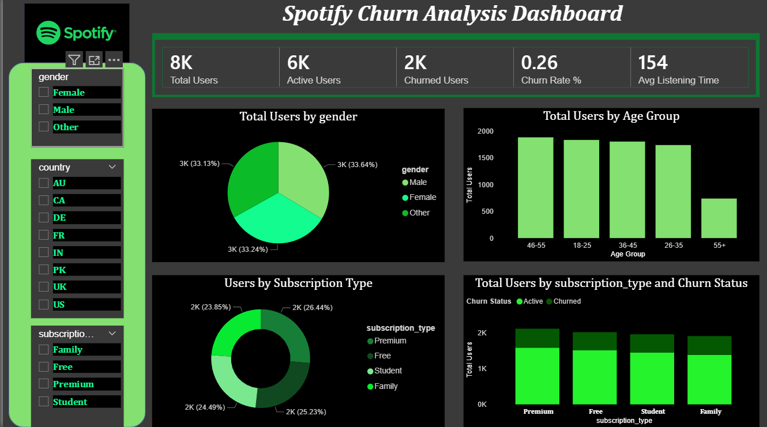

Slide 11
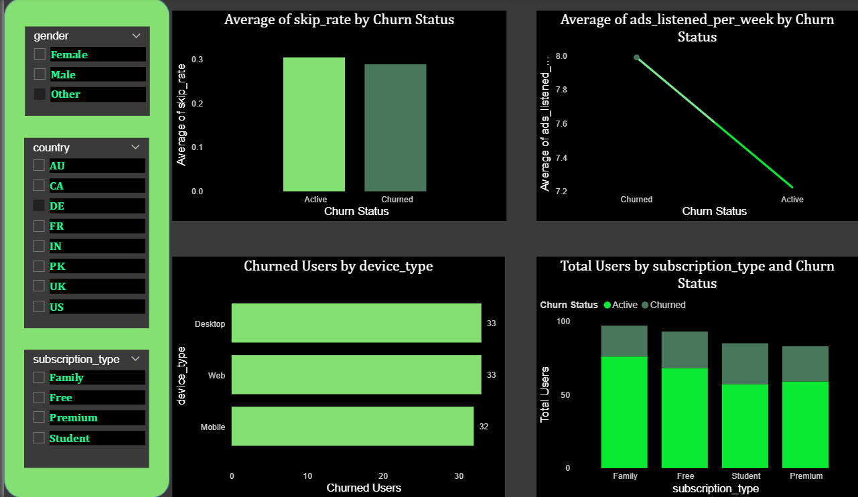

Slide 12
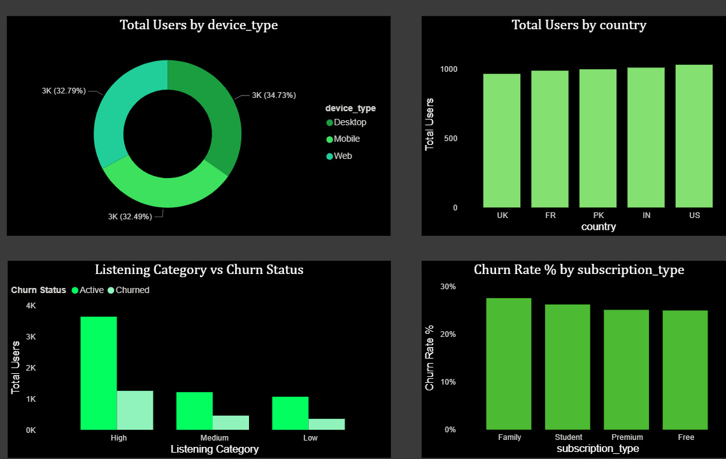

Slide 13
Key Insights
Users with high listening activity show lower churn behavior.
Family subscription plan has the highest churn rate among subscription types.
Desktop and Web users show slightly higher churn compared to Mobile users.
Users with high listening engagement form the majority of active users.
Skip rate differences indicate user engagement impacts retention.

Slide 14
Conclusion
This project successfully analyzes Spotify user behavior and customer churn using Power BI. Interactive dashboards and visual analytics helped identify key churn factors such as listening behavior, subscription type, and user engagement. The insights gained can support better customer retention strategies.

Slide 15
THANK YOU

